Slide 1
SC5010 - IBM HR Analytics Employee Attrition
Team members:
Duan Zhaoming, Zhou Runbing, Wang Jiwei
Notes:
Hi, everyone, I am Jiwei here are Zhaoming and Runbin. now we will present our project about the IBM HR Analytics Employee Attrition.

Slide 2




INTRODUCTION
Data Set : IBM HR Analytics Employee Attrition & Performance
35 Variables & 1470 Rows
Personal info: Gender, Age, Education, Marital Status, etc.
Work Experience: Job Level, Num Companies Worked, etc.
Company Rating: Job Involvement, Daily\Monthly Rating, etc.
Working Condition: Distance from Home, Business Travel, etc.
Benefits: Monthly Income, Percent Salary Hike, etc.
Notes:
This data set has 35 variables and about 1500 rows
There are information about 5 main categories, such as personal info, work experience, benefits, etc.

Slide 3
Objective Questions
Q1: What factors matter most in their attrition decision?
Q2: How to prevent employees from resigning？
Notes:
For this data set, there are two objective questions that we want to investigate.
The first Question is: What factors matter most in their attrition decision?
And the second Question is How can we prevent employees from resigning？
Employee Attrition will cause significant loss to the company. Usually, it will cost 10% of the annual salary of a position to hire a new employee for this position.
Hence, we are interested in this topic.

Slide 4
OUTLINE
Data
Pre-processing
Exploratory Data Analysis
Different
Algorithms
Encoding
PCA
Data Cleansing
SMOTE
Uni-variate
Bi-Variate
Multi-Variate
Correlation
Logistic Regression
SVM
Decision Tree
Random Forest
XGBoost
Notes:
This is the outline that how we carry out our project. There are mainly three steps.
We did the Data Pre-processing at first. Then we carried out the Exploratory Data Analysis and applied 5 different machine learning algorithms to the cleaned and balanced data.

Slide 5
DATA PREPARATION
Data
Categorical Variable
Ordinal Encoder
Label Encoder
Numeric Variable
Principal Components
One Hot Encoder
Clean Data
Train Set
Test Set
Balance

Slide 6
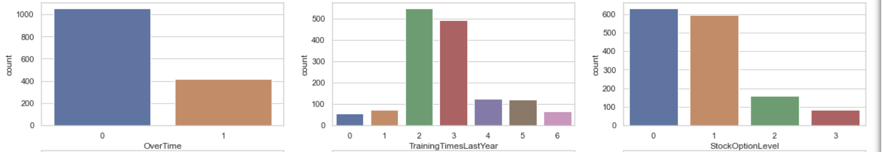
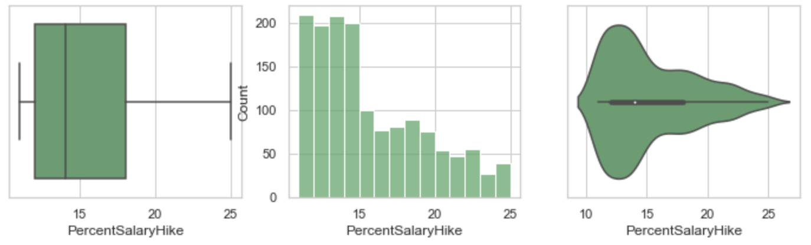
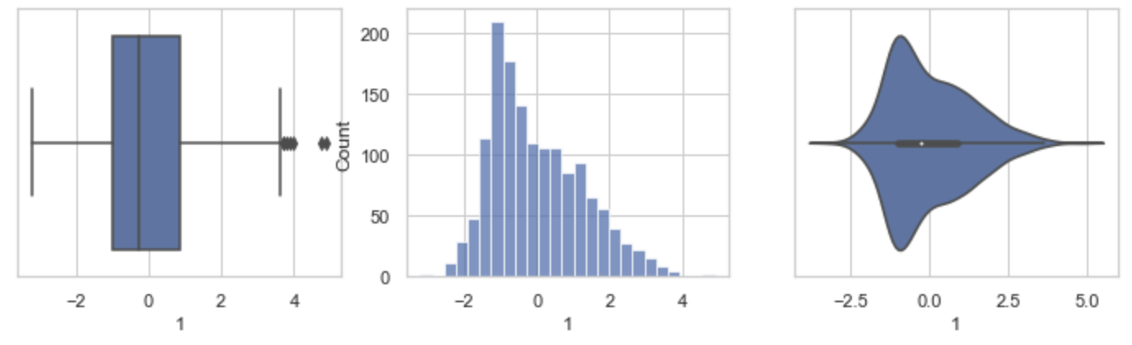
EDA – Uni-variate
Category Variable
Count Plot
Numeric Variable
Box
Plot
Hist
Plot
Principal Component
Box
Plot
Hist
Plot
Violin
Plot
Violin Plot

Slide 7
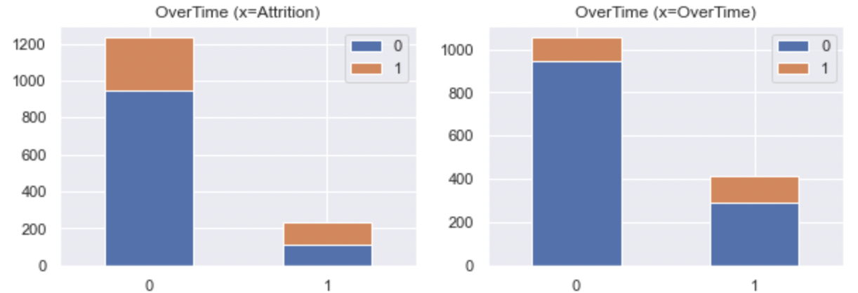
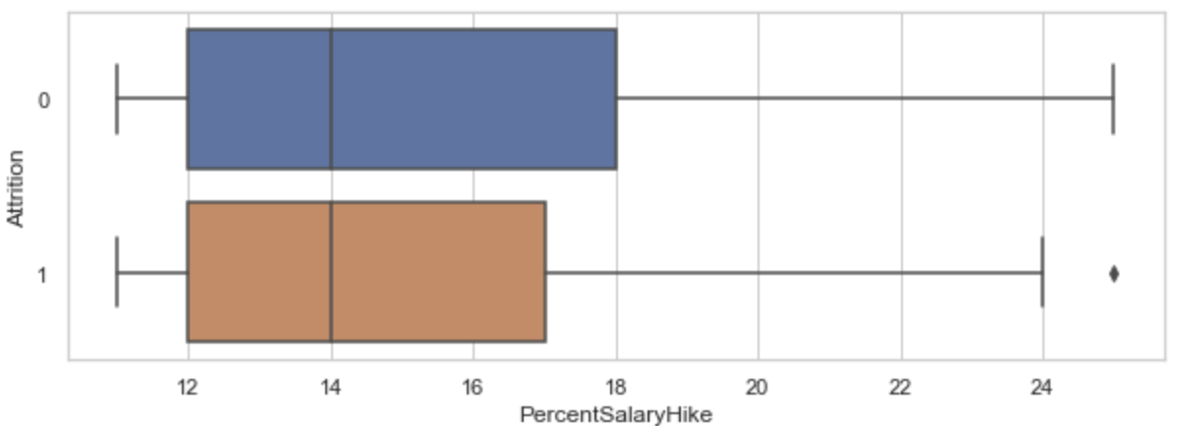
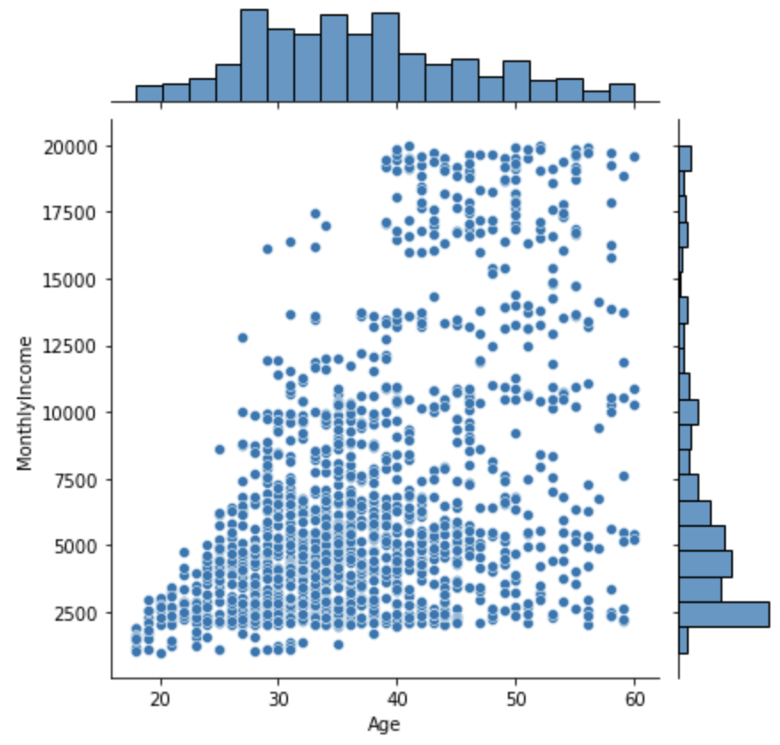
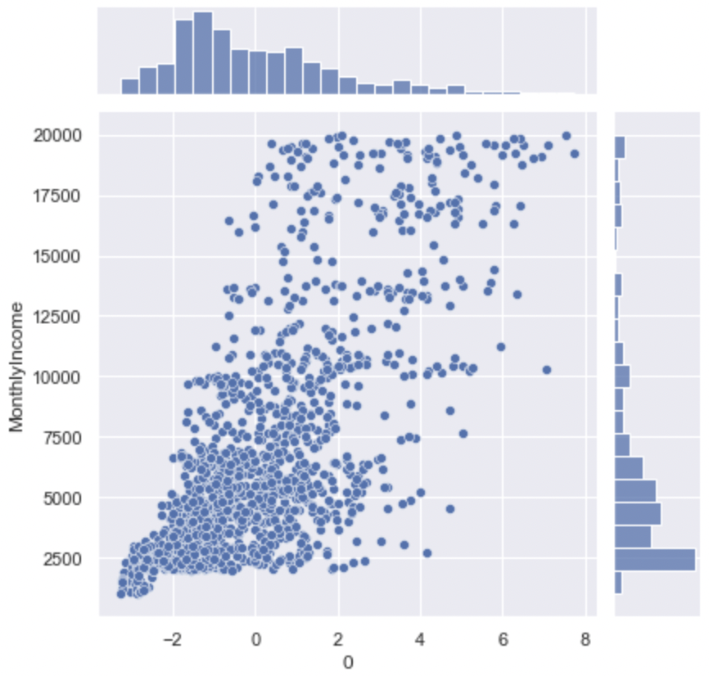
EDA – Bi-Variate
Category to Category
Bar Plot
Category to Numeric
Box Plot
Numeric to Numeric
Joint Plot
Significant Variables – Attrition, PerformanceRating, WorkLifeBalance, MonthlyIncome

Slide 8
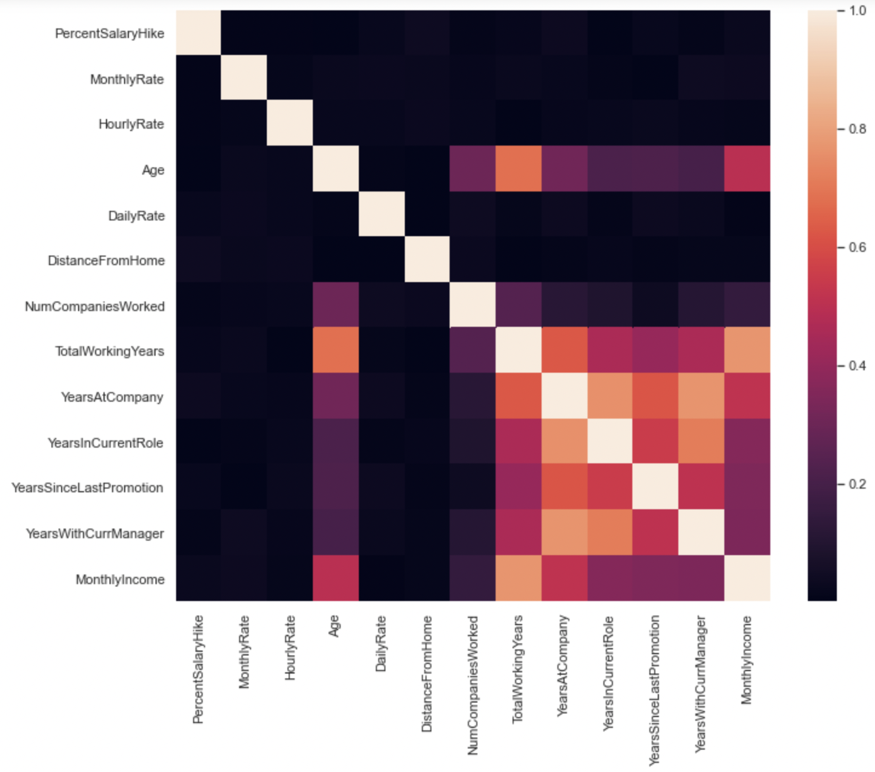
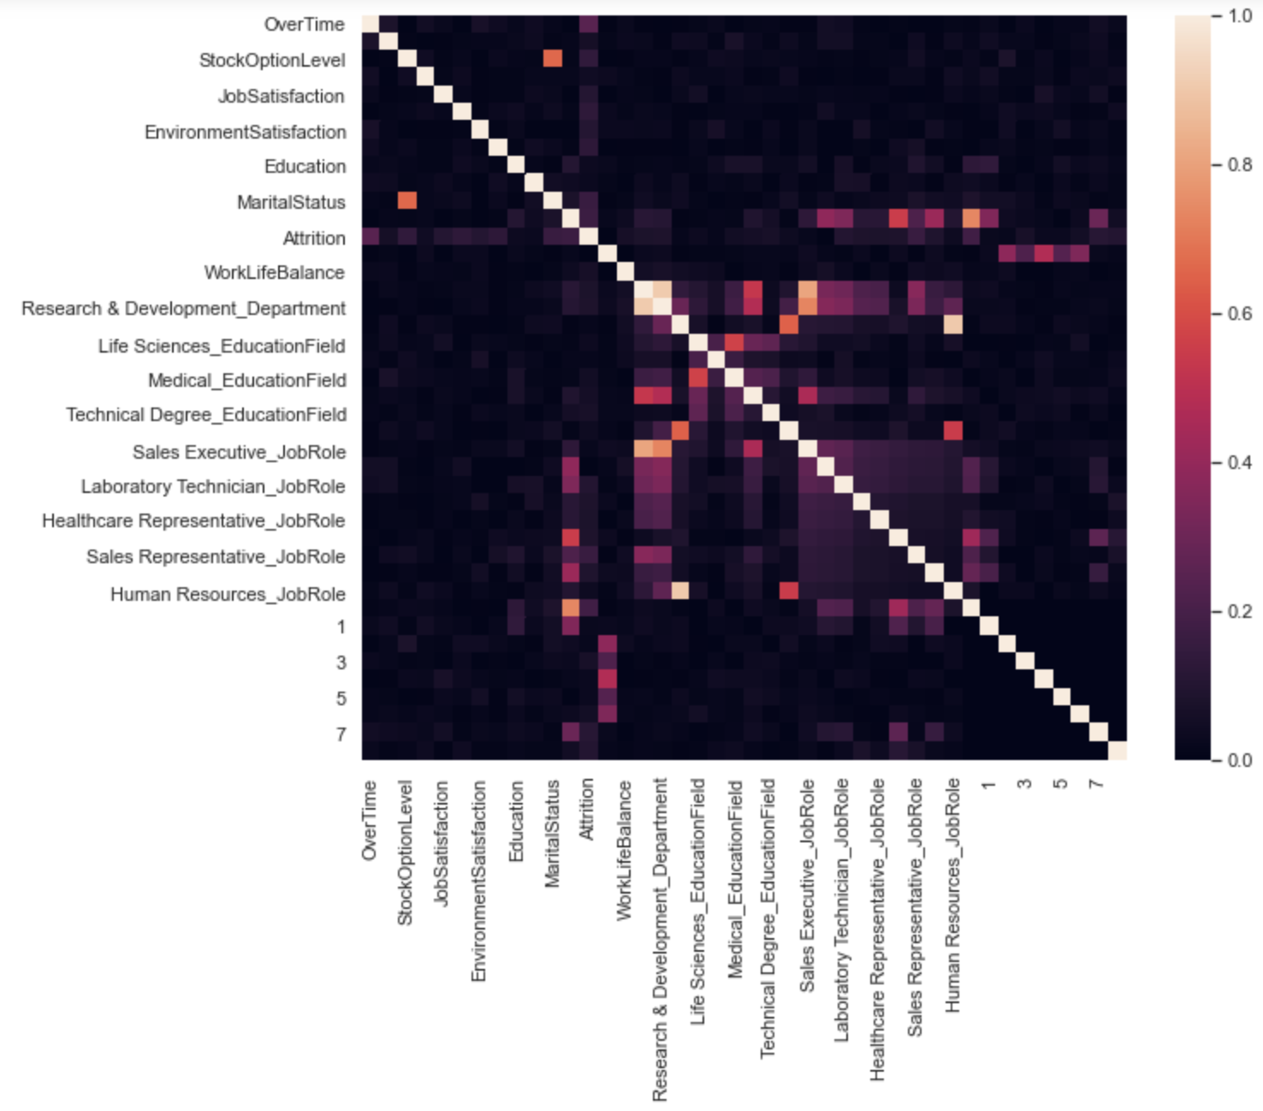
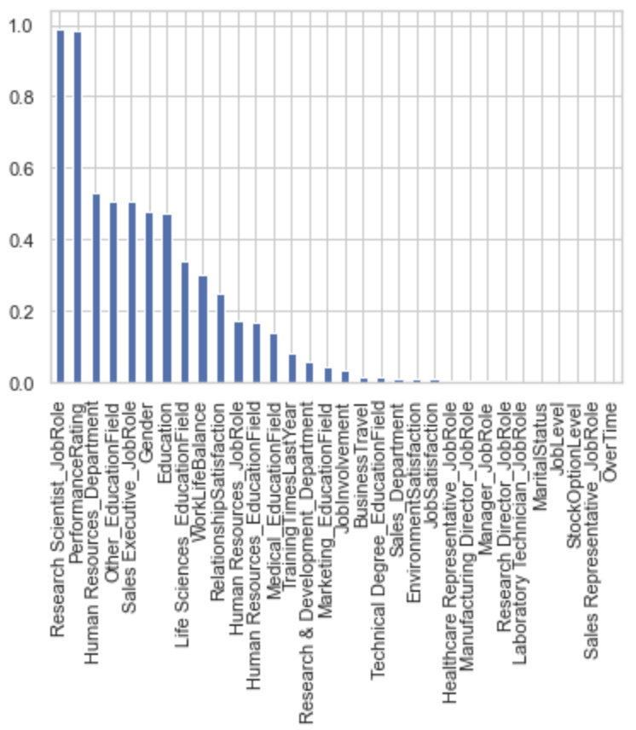
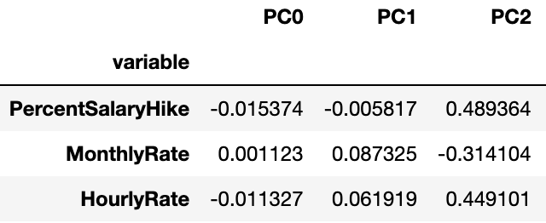
EDA – Multi-Variate
Usual Correlation
Numeric
Spearman Correlation
Any Data Type
Chi Square
Category
Principal Components
PC and Numeric

Slide 9
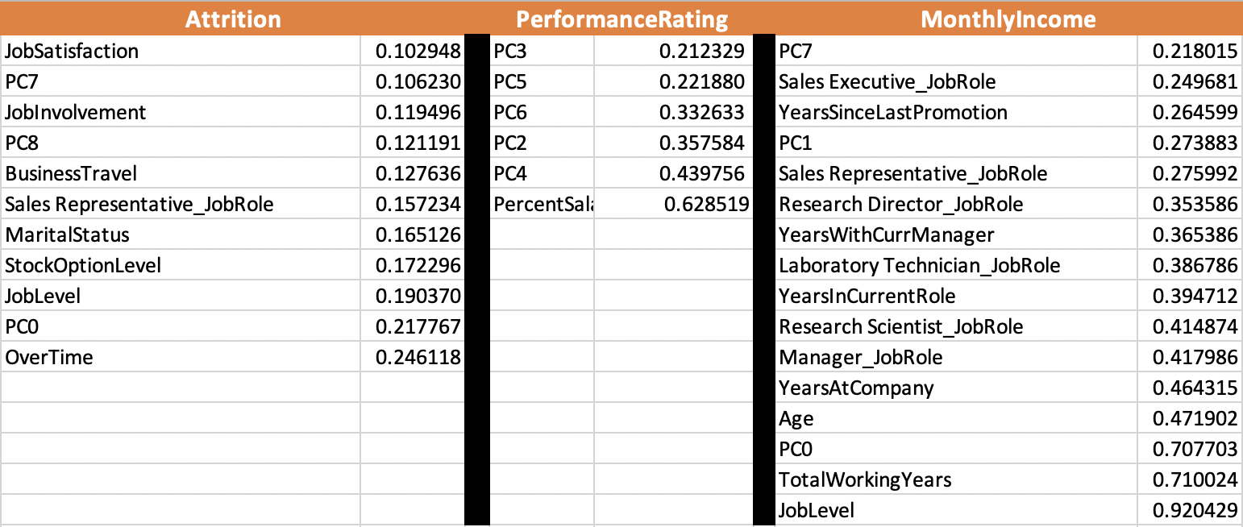
EDA – Most Correlated Variable
Notes:
Attrition 要不顺着排一下?

Slide 10
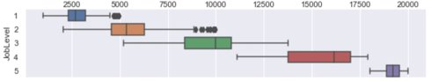
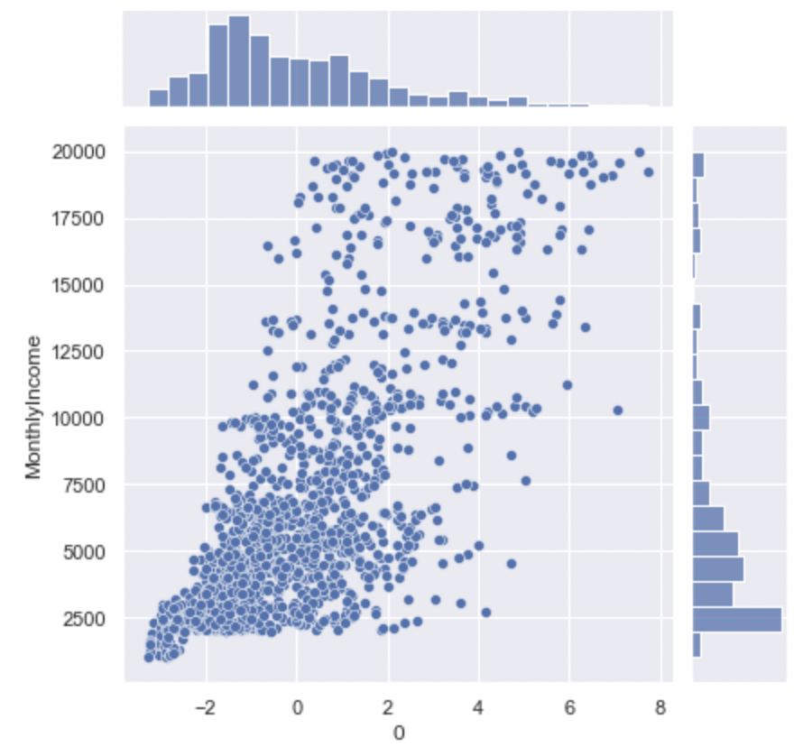
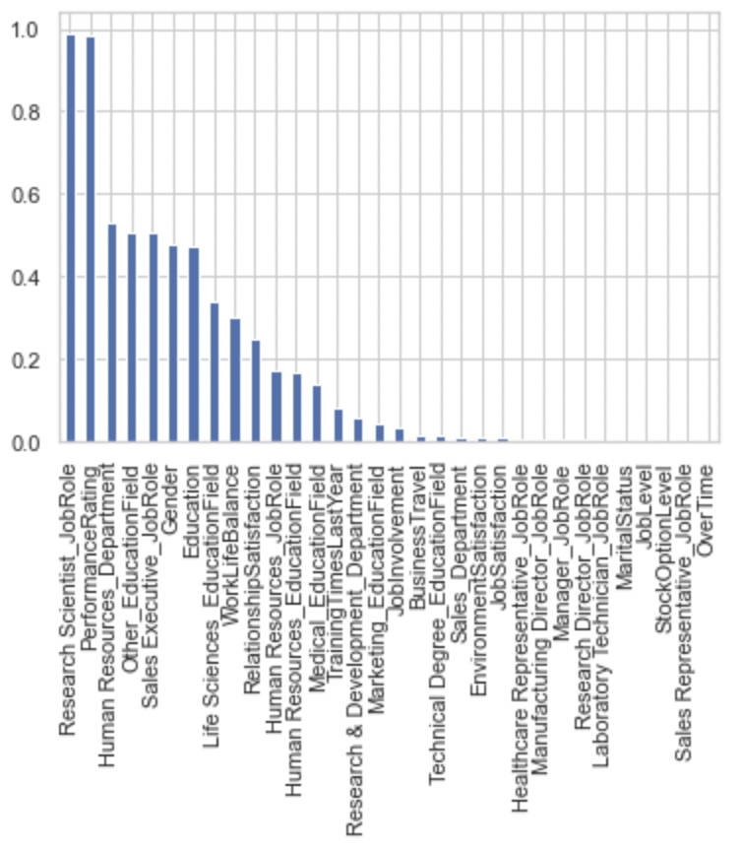
EDA – Insight
JobLevel shows significance for MonthlyIncome
PerformanceRatings show no significance for Attrition, while OverTime, JobLevel and etc show great significance with Attrition
Principal Component 0 shows significance for MonthlyIncome

Slide 11
MACHINE LEARNING APPROACHES
After
SMOTE
Random Search
Grid Search
Final Performance
After
PCA
Logistic Regression
(LR)
C
solver
Decision Tree
(DT)
splitter
max_depth
Random Forest
(RF)
bootstrap
max_depth
Support Vector Machines
(SVM)
eXtreme Gradient Boosting
(XGBoost)
penalty
max_features
min_samples_leaf
min_samples_split
n_estimators
max_features
min_samples_leaf
min_samples_split
C
degree
gamma
kernel
subsample
gamma
n_estimators
colsample_bytree
min_child_weight
max_depth

Slide 12
RESULTS
Test Set Result | Logistic Regression | SVM | Decision Tree | Random Forest | XGBoost
Accuracy | 0.864 | 0.847 | 0.765 | 0.864 | 0.830
F1-score | 0.548 | 0.118 | 0.355 | 0.459 | 0.265
Precision | 0.535 | 0.600 | 0.288 | 0.654 | 0.429
Recall | 0.523 | 0.065 | 0.463 | 0.354 | 0.191
Training Time | 0.2h | 12h | 1h | 2h | 20h
Notes:
Here are our final results for the 5 different machine learning models that we applied.
We can see that the Logistic Regression has the best performance for Accuracy, F1-score and Recall.
Logistic Regression also has the shortest training time which is about 12 minutes

Slide 13
RESULT – Model Recommendation
Logistic Regression: best performance for Accuracy, Precision and Recall
Logistic Regression : shortest training time (12 minutes)
Logistic Regression limitation: tough to obtain complex relationships → may use more powerful and compact algorithms such as Neural Networks
SVM, Random Forest, XGBoost limitation: worse performance + overfitted for training set (Accuracy of 100%)
Other Limitation: high time complexity and the poor run-power of our personal laptops → might not reflect the absolute global optimum
Notes:
However, the limitation of Logistic Regression is that it is tough to obtain complex relationships using logistic regression. We may use more powerful and compact algorithms such as Neural Networks .
SVM, Random Forest, and XGBoost overfitted for the training set, which achieve Accuracy of 100%. But for test set, all three of them are worse than the Logistic Regression.
Another limitation is about the high time complexity and the poor run-power of our personal laptops. We have to narrow the optimal parameter range step by step rather than brute force searching all possible combinations. Hence, our result might not reflect the absolute global optimum. Further improvement could be made by looping more combinations of parameters.

Slide 14
RESULT - Objective Questions
Q1: What factors matter most in their attrition decision?
Less working years would usually result in low MonthlyIncome, which is one of the main factors cause people to resign.
Main Factors:
Low MonthlyIncome
Younger Group
OverTime
...
Q2: How to prevent employees from resigning?
Reduce the OverTime working hours / Increase the OverTime extra salary
Provide better welfare for young employee:
Stock Option Level
MonthlyIncome
Notes:
Now we go back to our original questions, There are three most important factors for attrition.
Low MonthlyIncome, younger group and overtime.
It is reasonable that the people with relatively low monthly Income tend to attrit more likely. Then they can get higher salary and promoted by joining a new company.
Usually, these people are also the younger group in the company.
For the second question,as the company manager, how can we prevent employees from resigning?
We can reduce the overtime working hours or Increase the OverTime extra salary
For the employees who are more likely to attrit, we can provide better welfare for them, such as increasing the monthly income and provide more stock option level.
Now it comes to the end of our presentation, thank you for listening!

Slide 15
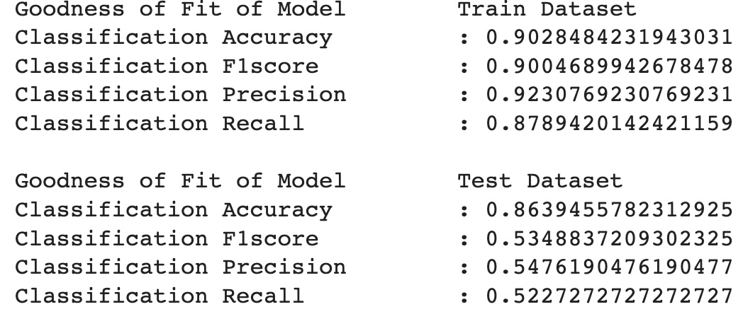
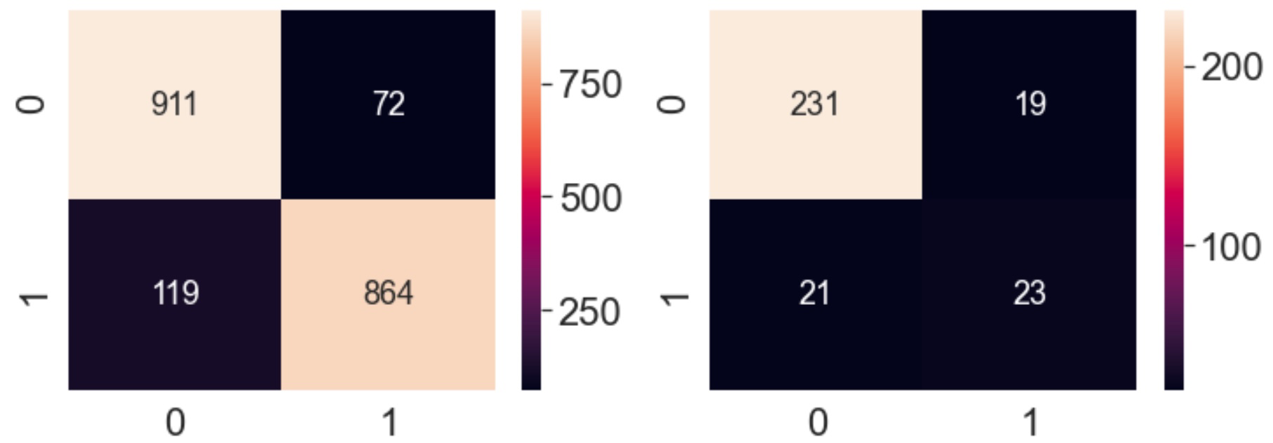
5.1 Logistic Regression
Training set
Test set
Notes:
These are the confusion matrix for both the training set and test set of our models.

Slide 16
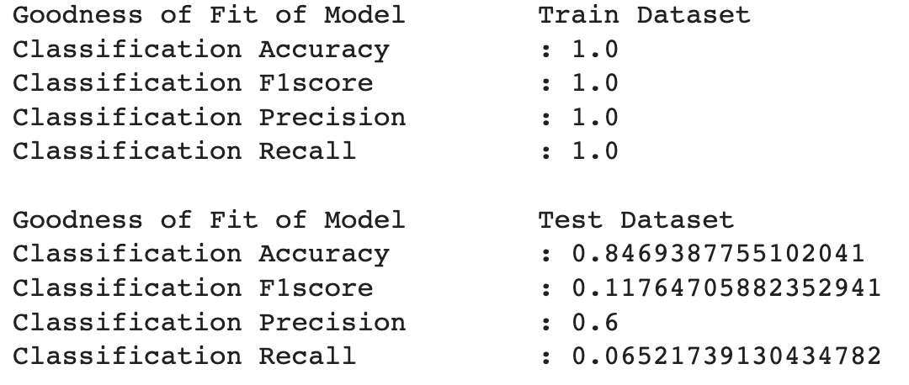
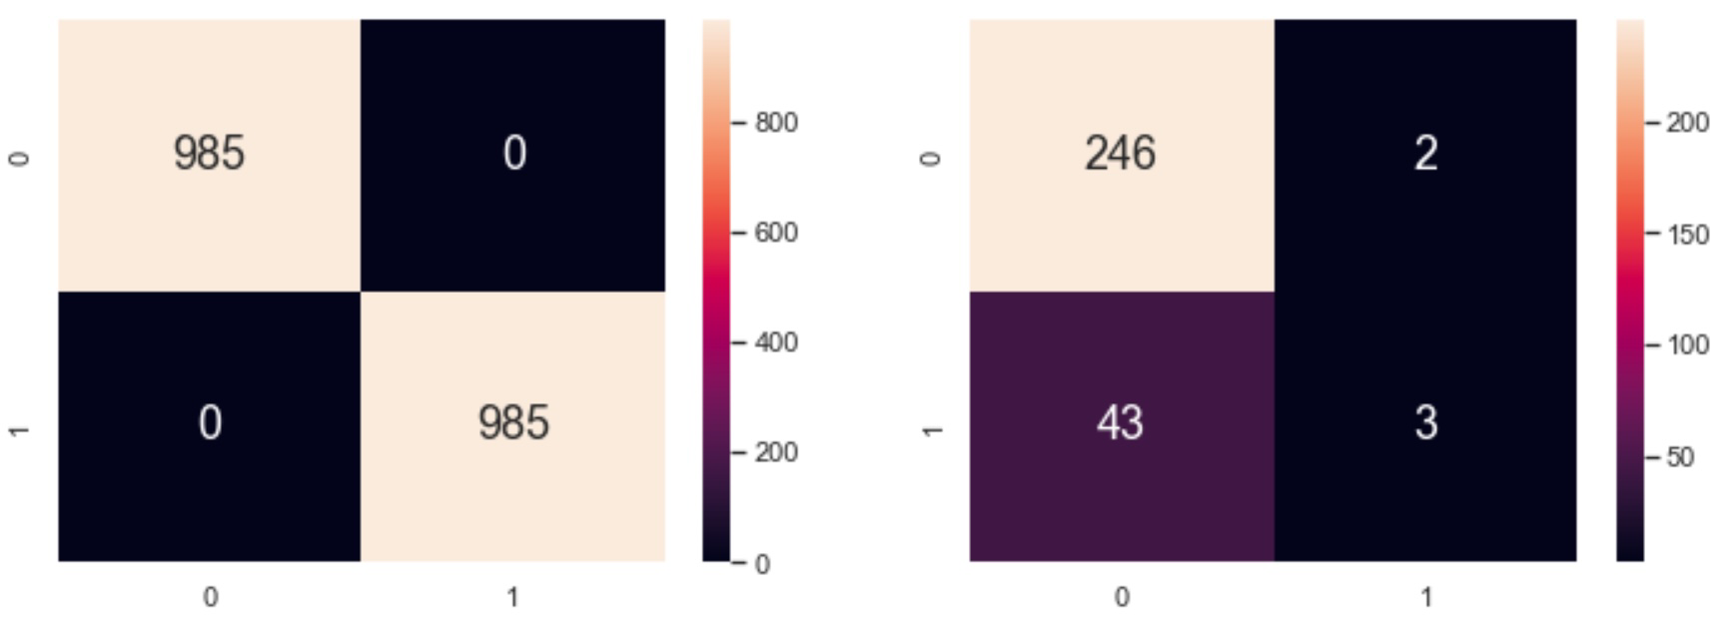
5.2 SVM
Training set
Test set

Slide 17
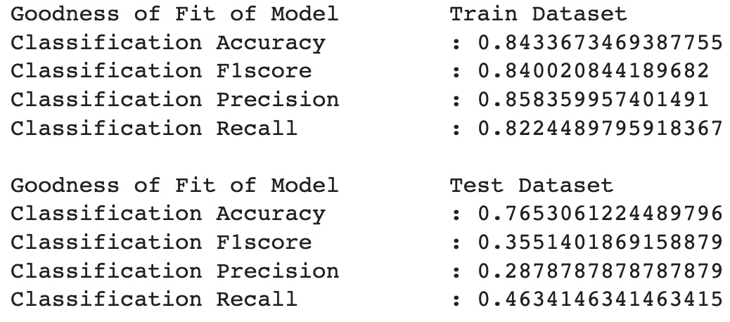
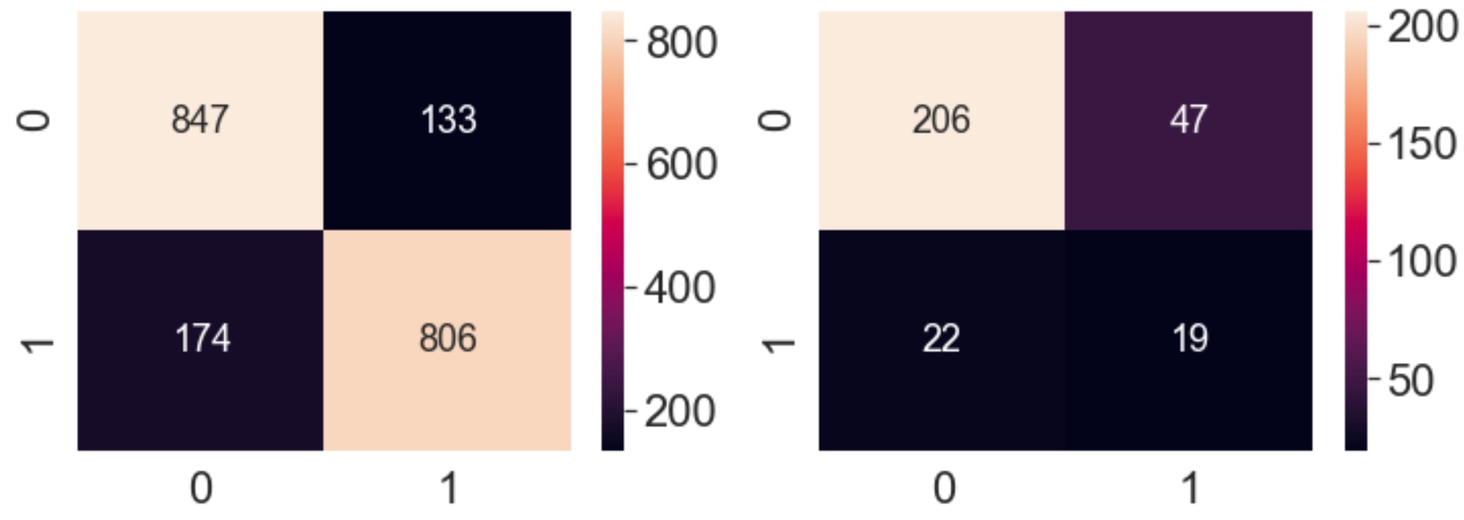
5.3 Decision Tree
Training set
Test set

Slide 18
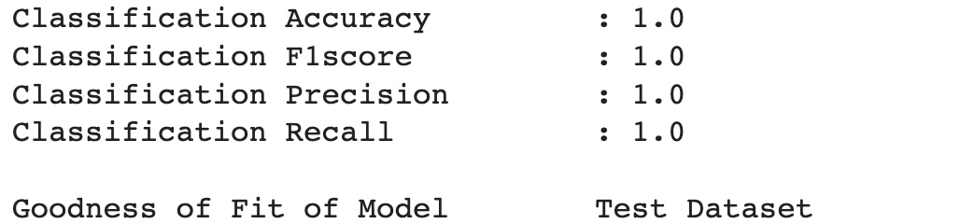
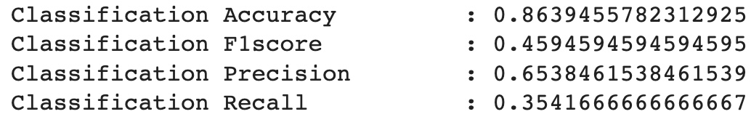
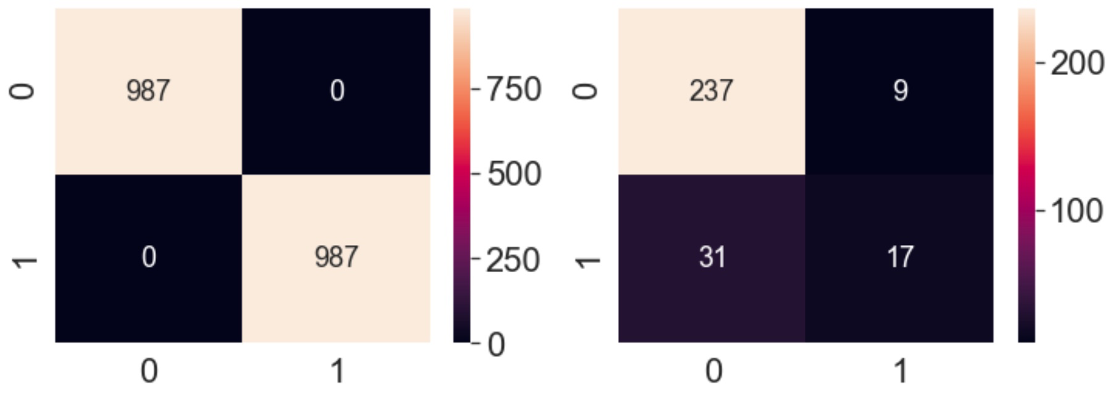
5.4 Random Forest
Training set
Test set

Slide 19
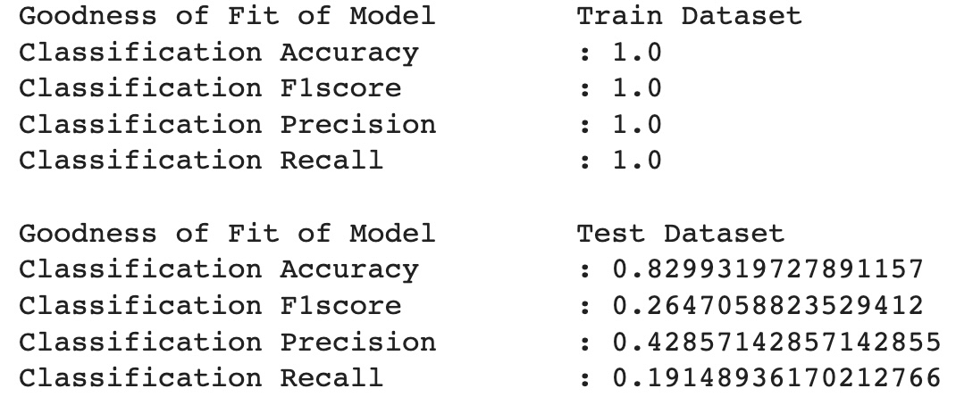
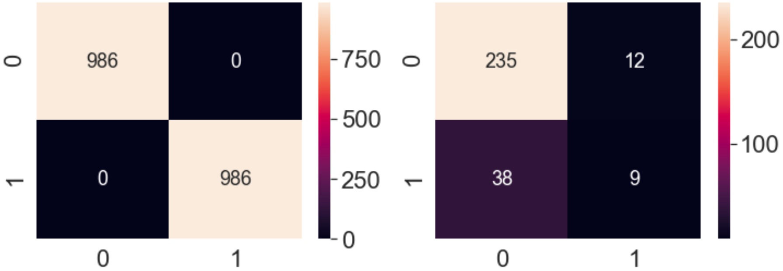
5.5 XGBoost
Training set
Test set

